Slide 1
Retail Budget
V 2.1

Slide 2
Index
No | Sprint Name | Sprint No | Login-User
1 | Google Calendar connected with Retail Budget App | 3
2 | Flash Report Entries Multiple option Edit of Date & type of income Selection rights, to the Store managers, for uploading of flash Report. | 6

Slide 3
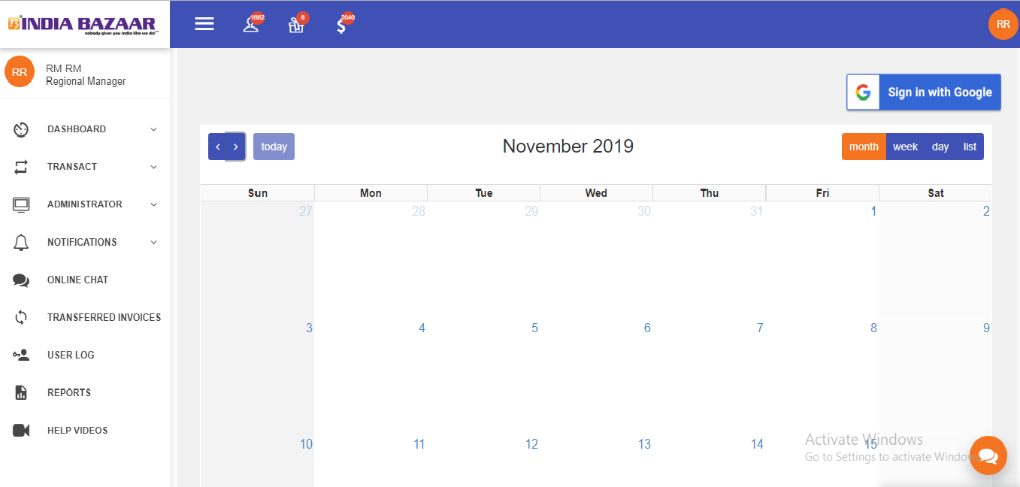
Google Calendar connected with Retail Budget App
Then RM click on the google sign button so open so redirect to google calendar page and open the current month meeting details in calendar page
Current month calendar

Slide 4
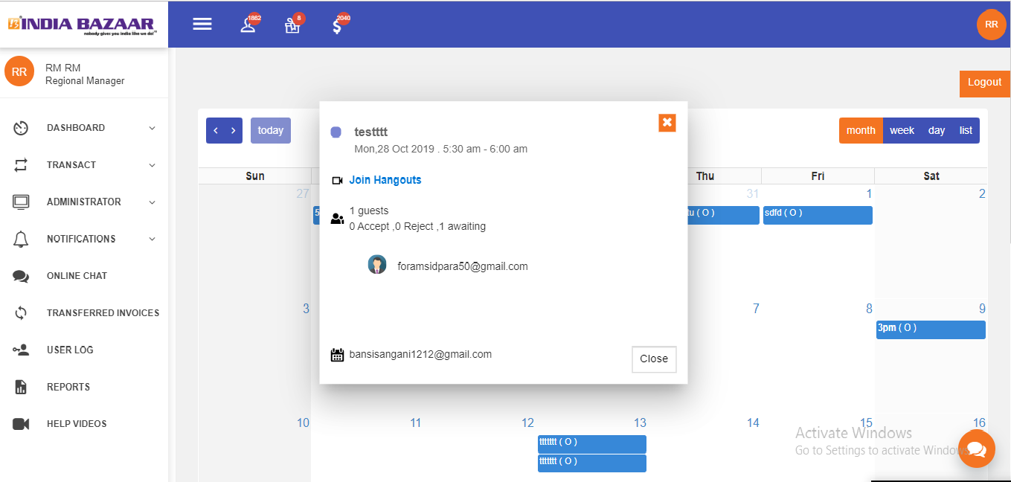
RM click on the Logout button so logout the google account and see the simple calendar in dashboard
See the current month meeting note
RM can click on the meeting tab so open the pop-up menu
See the meeting details and how many user Accept, Reject and Awaiting meting details.

Slide 5
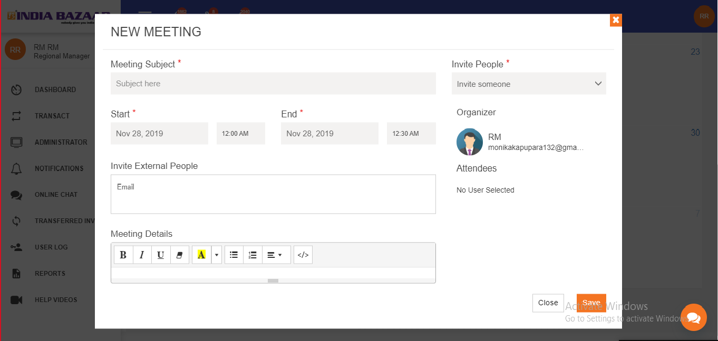
Add Meeting
Select the invite people
Enter meeting subject
See the organizer name
Select the meeting start date and time
Select the meeting End date and time
If RM have email-id so enter the user Mail-id
See the invite people name
Enter the meeting agenda

Slide 6
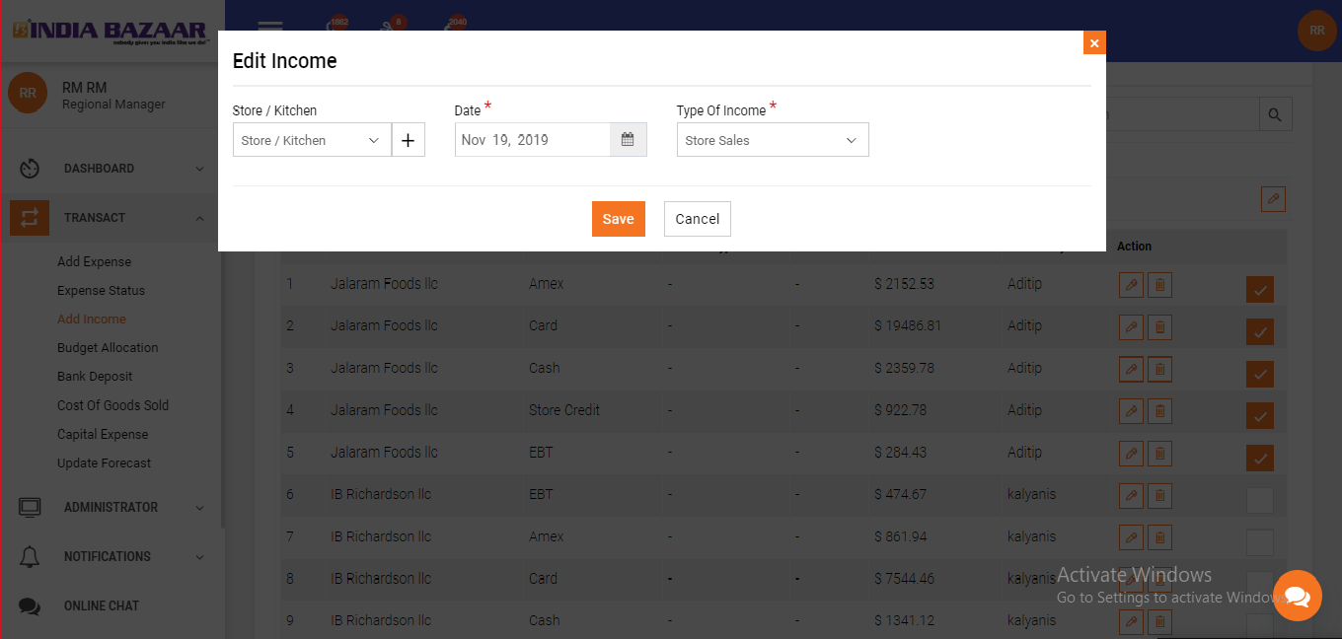
Flash Report Entries multiple option Edit of Date & type of income Selection rights, to the Store managers, for uploading of flash Report.
Select the month and data
Select the income type
Select the store/Kitchen name

